Slide 1
Computer Architecture
Lab 1

Slide 2
Revision on:
❑ Conversion from hexadecimal to binary and vice versa.
❑Positive and negative values in binary.
❑Odd and even numbers in binary.
❑Addition of binary numbers
❑Subtraction of binary numbers using 2’s complement.
❑Digital logic gates and simple circuits.
❑ Multiplexer.

Slide 3
Hexadecimal Digits
hexadecimal | Binary
0 | 0 | 0 | 0 | 0
1 | 0 | 0 | 0 | 1
2 | 0 | 0 | 1 | 0
3 | 0 | 0 | 1 | 1
4 | 0 | 1 | 0 | 0
5 | 0 | 1 | 0 | 1
6 | 0 | 1 | 1 | 0
7 | 0 | 1 | 1 | 1
8 | 1 | 0 | 0 | 0
9 | 1 | 0 | 0 | 1
A | 1 | 0 | 1 | 0
B | 1 | 0 | 1 | 1
C | 1 | 1 | 0 | 0
D | 1 | 1 | 0 | 1
E | 1 | 1 | 1 | 0
F | 1 | 1 | 1 | 1
Each hexadecimal Digit must be represented in 4 binary digits
Hexadecimal
F A C D
Binary
1111101011001101
Binary
1010000000111011
Hexadecimal
A 0 3 B

Slide 4
Positive & Negative Values In Binary
Hexadecimal
A 3 9 B
F A C D
Positive Number
Negative Number
Binary
0101101110100101
1111101011001101
Most Significant Bit
Most Significant Bit
0 = Positive
1 = Negative
0 = Positive
1 = Negative

Slide 5
Even & Odd Numbers In Binary
Hexadecimal
8 2 1 F
F A C D
Even Number
Odd Number
Binary
1111101011001101
1011010011110100
Least Significant Bit
Least Significant Bit
0 = Even
1 = Odd
0 = Even
1 = Odd

Slide 6
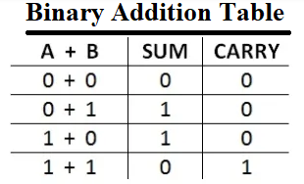
Addition Of Binary Numbers
2+5
0010
+ 0101
----------------
0111 (No overflow)
5+3
0101
+ 0011
-----------
1000 (overflow occurred)
No change in the sign
Change in the sign

Slide 7
Subtraction Of Binary Numbers
0011 = 3
1100
+ 1
----------
1101 = -3
5-3
0101
- 0011
----------------
5+(-3)
0101
+ 1101
----------------
0010
1’s complement
2’s complement

Slide 8
Subtraction Of Binary Numbers
00000001 = 1
11111110
+ 1
----------
11111111 = -1
1
1’s complement
2’s complement

Slide 9
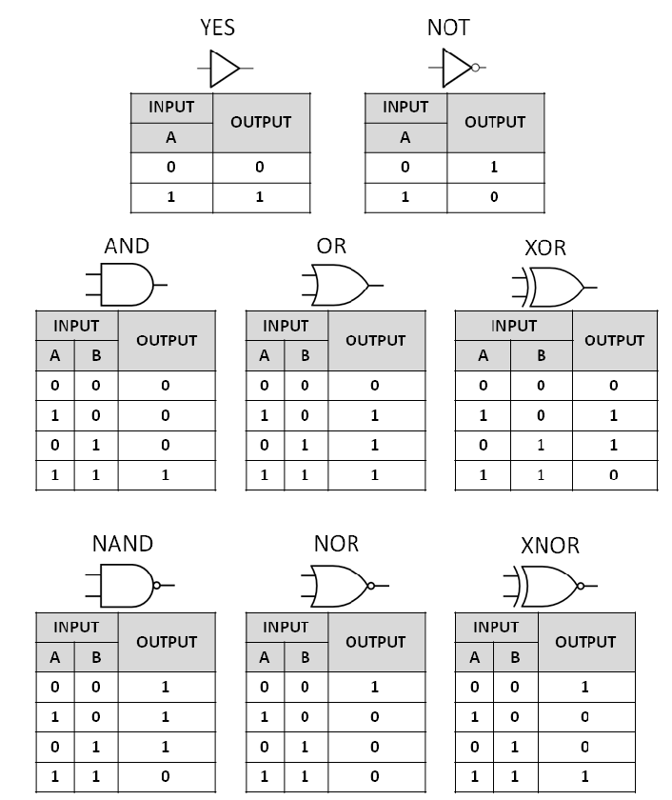
Digital Logic Gates

Slide 10
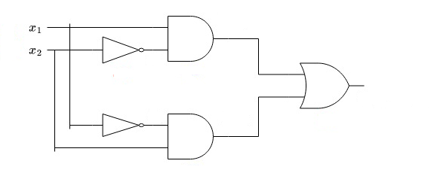
Digital Logic Gates
x1 | x2 | y
0 | 0
0 | 1
1 | 0
1 | 1

Slide 11
Digital Logic Gates
x1 | x2 | y
0 | 0 | 0
0 | 1
1 | 0
1 | 1
0
0
0
0
1
0
1
0
0

Slide 12
Digital Logic Gates
x1 | x2 | y
0 | 0 | 0
0 | 1 | 1
1 | 0
1 | 1
0
0
0
1
0
1
1
1
1

Slide 13
Digital Logic Gates
x1 | x2 | y
0 | 0 | 0
0 | 1 | 1
1 | 0 | 1
1 | 1
1
1
1
0
1
1
0
0
0

Slide 14
Digital Logic Gates
x1 | x2 | y
0 | 0 | 0
0 | 1 | 1
1 | 0 | 1
1 | 1 | 0
1
1
0
1
0
0
0
1
0

Slide 15
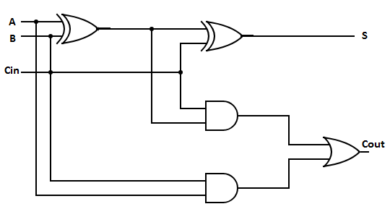
Digital Logic Gates
A | B | Cin | S | Cout
0 | 0 | 0
0 | 0 | 1
0 | 1 | 0
0 | 1 | 1
1 | 0 | 0
1 | 0 | 1
1 | 1 | 0
1 | 1 | 1

Slide 16
Digital Logic Gates
A | B | Cin | S | Cout
0 | 0 | 0 | 0 | 0
0 | 0 | 1
0 | 1 | 0
0 | 1 | 1
1 | 0 | 0
1 | 0 | 1
1 | 1 | 0
1 | 1 | 1
0
0
0
0
0
0
0
0

Slide 17
Digital Logic Gates
A | B | Cin | S | Cout
0 | 0 | 0 | 0 | 0
0 | 0 | 1 | 1 | 0
0 | 1 | 0
0 | 1 | 1
1 | 0 | 0
1 | 0 | 1
1 | 1 | 0
1 | 1 | 1
0
0
0
1
1
0
0
0

Slide 18
Digital Logic Gates
A | B | Cin | S | Cout
0 | 0 | 0 | 0 | 0
0 | 0 | 1 | 1 | 0
0 | 1 | 0 | 1 | 0
0 | 1 | 1 | 0 | 0
1 | 0 | 0 | 1 | 0
1 | 0 | 1 | 0 | 0
1 | 1 | 0 | 0 | 1
1 | 1 | 1 | 1 | 1
1
0
1
1
1
0
1
1

Slide 19
Multiplexer
S1
0
S0
0
Mux
4x1
a
00
b
01
a
c
10
d
11
Number of selections = log₂(inputs)

Slide 20
Multiplexer
Number of selections = log₂(inputs)
16 × 1 multiplexer
4 selection lines.
Inputs
Outputs
32 × 1 multiplexer
5 selection lines.

Slide 21
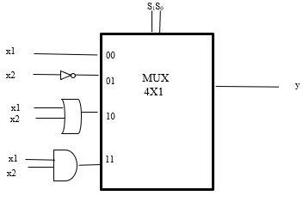
Multiplexer
x1 | x2 | S1 | S0 | y
0 | 0 | 0 | 0
0 | 1 | 0 | 1
1 | 0 | 1 | 0
1 | 1 | 1 | 1

Slide 22
Multiplexer
0
0
0
x1 | x2 | S1 | S0 | y
0 | 0 | 0 | 0 | 0
0 | 1 | 0 | 1
1 | 0 | 1 | 0
1 | 1 | 1 | 1

Slide 23
Multiplexer
0
1
x1 | x2 | S1 | S0 | y
0 | 0 | 0 | 0 | 0
0 | 1 | 0 | 1 | 0
1 | 0 | 1 | 0
1 | 1 | 1 | 1
1
0

Slide 24
Multiplexer
10
x1 | x2 | S1 | S0 | y
0 | 0 | 0 | 0 | 0
0 | 1 | 0 | 1 | 0
1 | 0 | 1 | 0 | 1
1 | 1 | 1 | 1 | 1
1
0
1

Slide 25
Multiplexer
11
x1 | x2 | S1 | S0 | y
0 | 0 | 0 | 0 | 0
0 | 1 | 0 | 1 | 0
1 | 0 | 1 | 0 | 1
1 | 1 | 1 | 1 | 1
1
1
1

Slide 26
Assessments
Coursework: ❑ In-class Assessment 1 –> Week 8 20%
❑ In-class Assessment 2 –> Week 11 20%
Unseen : ❑ Written Exam 60%

